Slide 1
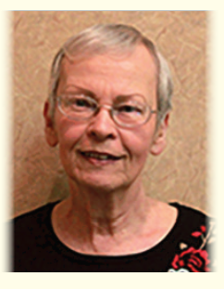
Tonight we celebrate the existence of a truly remarkable person. In Loving Memory of:
Shirley

Slide 2
Shirley was a Life Member of the ASHE Franklin Section, a ASHE Franklin Past President, and long held the position of Section Secretary.
At the conclusion of her term as ASHE National Director (1996 to 2002), she was appointed National President’s Assistant, retiring in December 2019.
She served on the National Board as Chair of the Resource Center and History Committee and a member of the National Conference and Nominating Committees.

Slide 3
She was selected by ASHE National President John Hetrick to receive the National President’s Award at the 2011 ASHE National Conference. John credited her administrative leadership to the National Board by maintaining a log of to-do items for the Executive Board members and all standing Committee Chairs, along with maintaining a frequent dialog with all Sections on items of interest and need.
Shirley retired from the Pennsylvania Department
of Transportation, District 1-0 at Oil City in 2005 as a Clerk Stenographer after 35 years.

Slide 4
ASHE Franklin bestowed one of the two scholarships in honor of Shirley during the January Meeting in 2020.
The Scholarship provides up to four $500 Scholarships to students who reside or attended school in Crawford, Erie, Forest, Mercer, Venango or Warren Counties and are pursuing a career or course of study in Civil Engineering or Transportation/Highway related fields.

Slide 5
Shirley spent her extra time providing cancer victims with encouragement, stressing the importance of their attitude on life.
As a four-time cancer survivor, she told people “the only thing we can do is play on the one thing we have and that is our attitude…
emphasizing that life is 10% what happens to us and
90% how we react to it.”

Slide 6
Along with her husband John,
they have 3 sons:
David of Wake Forest, NC,
Jay of Franklin, PA and
Jim of Erie, PA.
They have 5 grandchildren.
She resided in Cochranton, PA and
enjoyed spending time with her grandchildren, traveling, playing bingo, going to auctions, gardening, cooking for her family and relaxing at the family cottage located along the Allegheny River where she enjoyed riding in their hovercraft, made by John.

Slide 7
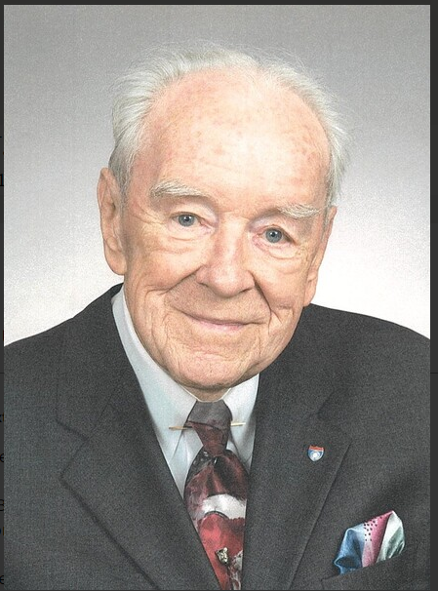
Our Scholarships are In Memory of:
BJ Smith
(1919 – 2018)
Shirley Stuttler
(1948 – 2022)

